Slide 1
GrowSmart
An ML based Intelligent Recommendation System for Crops and Fertilizers
Under the Guidance of
Dr. S. Kusuma
By
R M Sai Mohit (19699A0544)
M Madhusudhan (19699A0524)
B Jagadeesh (19699A0517)
K V Hari Prasad (19699A0513)
Computer Science and Engineering
Madanapalle Institute of Technology and Science
Andhra Pradesh

Slide 2
CONTENTS
Abstract
UML Diagram
Model Design
Database Design
Dataset
List of features
Algorithms Used
Accuracy of ML Algorithms
Algorithm with high Accuracy
References

Slide 3
ABSTRACT
Agriculture is a major source of income and employment in India. The most prevalent problem faced by Indian farmers is that they do not select the appropriate crop for their land and do not use the appropriate fertilizer. They will experience a significant drop in production as a result of this. GrowSmart has been used to solve the farmers difficulties. GrowSmart is a modern farming strategy that employs research data on soil properties, soil types, and crop yield statistics to recommend the best crop to farmers as well as fertilizer recommendations. This decreases the number of times a crop is chosen incorrectly and increases productivity. The aim of this analysis is to develop a system which helps the farmers to recommend a crop for the site specific parameters with high accuracy and efficiency with the help Machine Learning (ML) approaches.

Slide 4
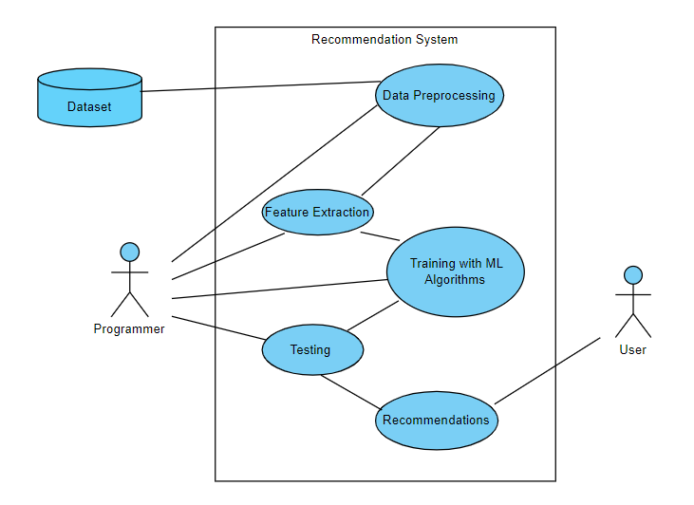
UML DIAGRAM
Use Case Diagram
(Programmer End)

Slide 5
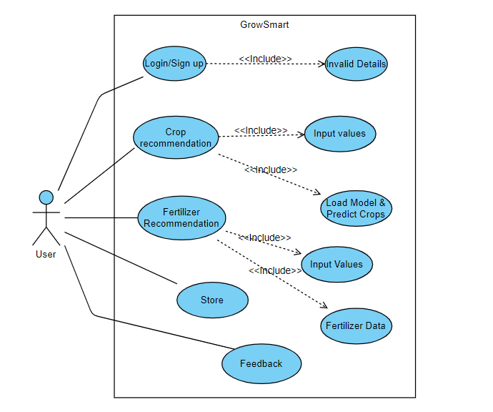
UML DIAGRAM
Use Case Diagram
(User’s End)

Slide 6
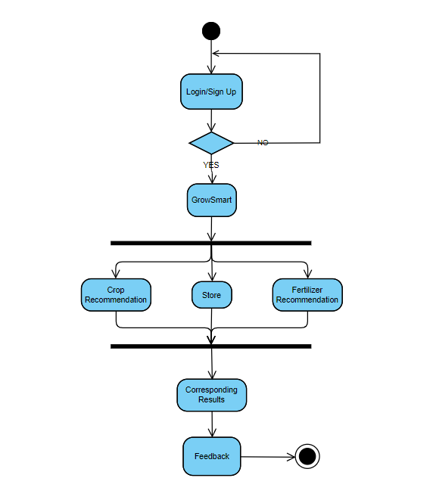
UML DIAGRAM
Activity Diagram (User’s End)

Slide 7
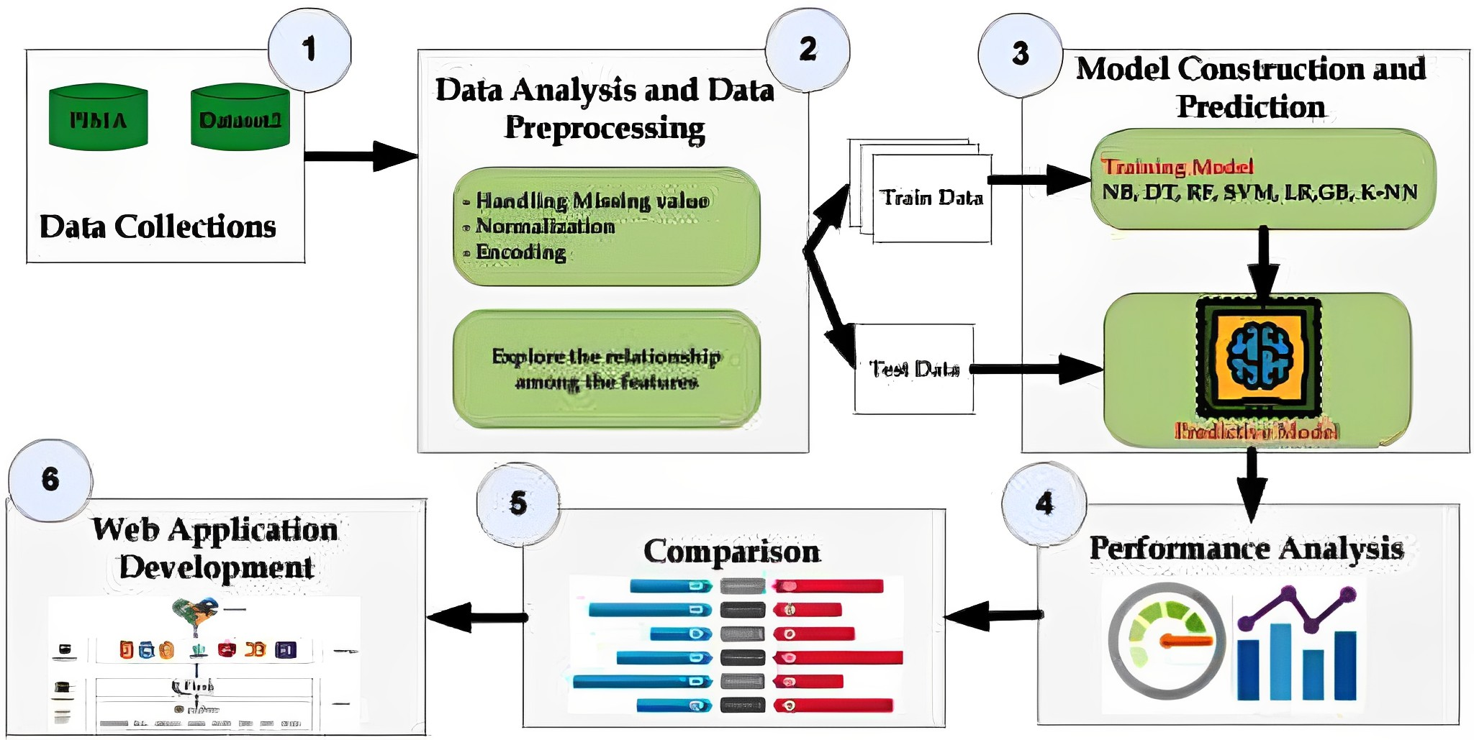

DATA FLOW DIAGRAM
Dataset
Train Data
Training Model
NB,DT,RF,SVM,LR,GB,KNN
Handling Missing Data &
Normalization
Explore the relationship among the features
PREDICTIVE MODEL
Test Data

Slide 8
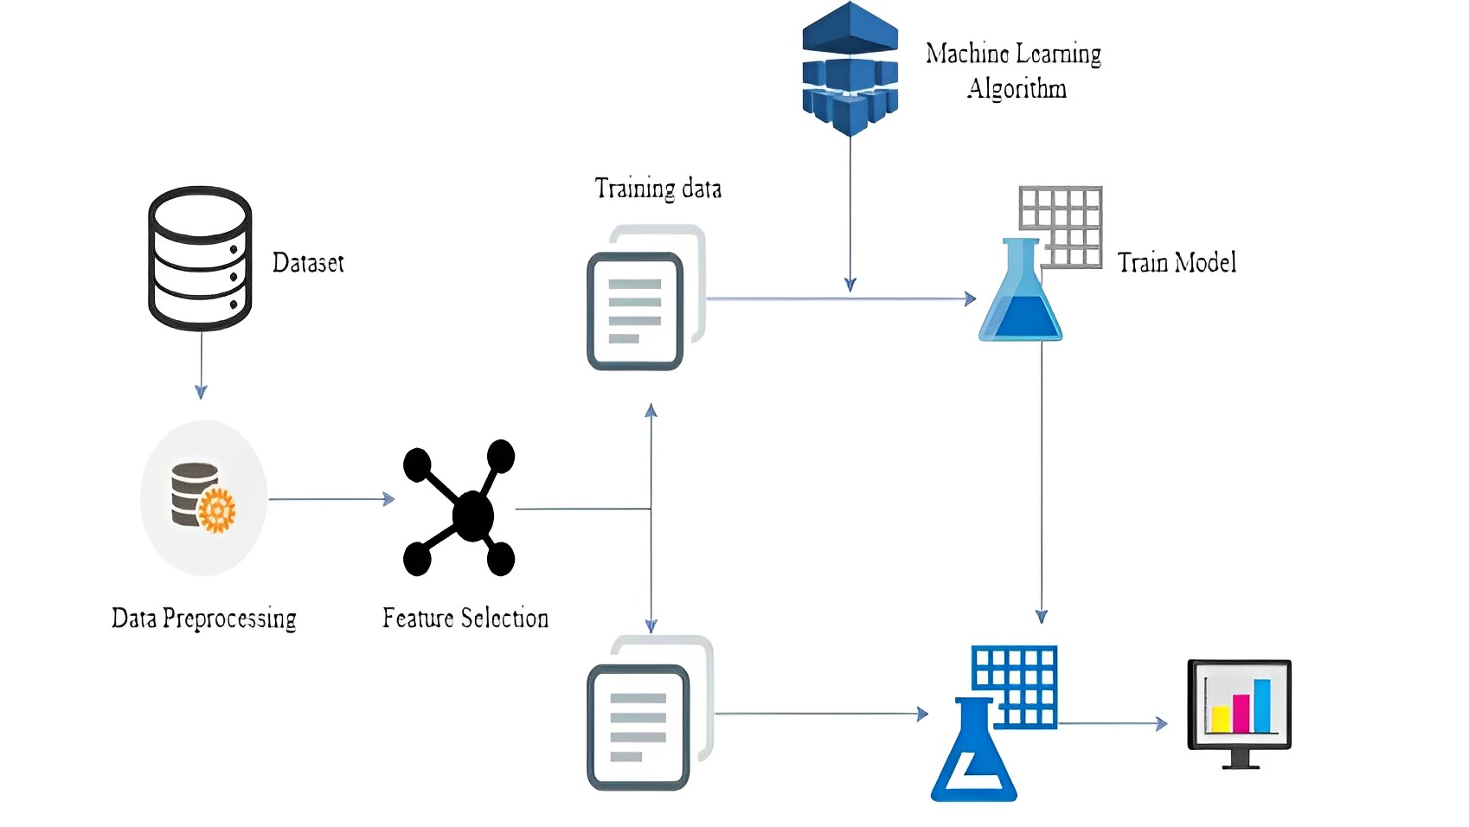
MODEL DESIGN

Slide 9
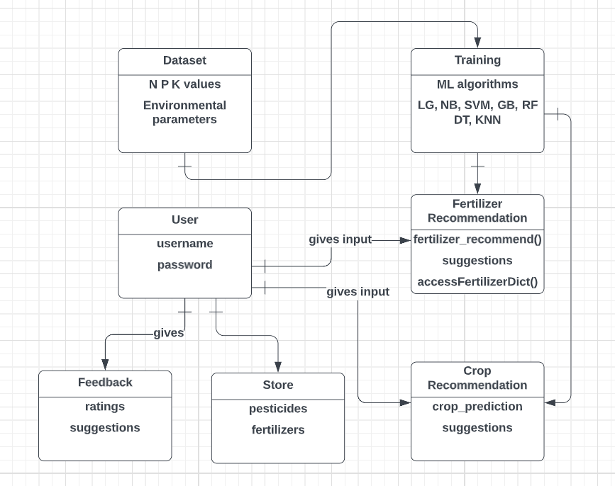
DATABASE DESIGN

Slide 10
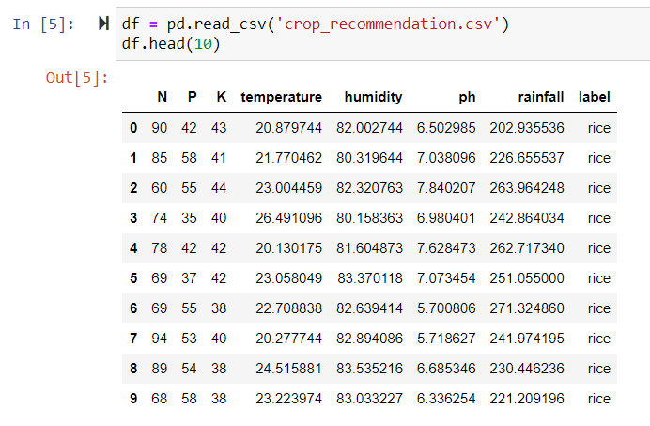
DATASET
The datasets consists of several parameters and one target label i.e. Outcome. Parameters includes their NPK values, Temperature, ph and so on.

Slide 11
LIST OF FEATURES
Features | Description
N | Nitrogen content in the soil.
P | Phosphorous content in the soil.
K | Potassium content in the soil.
Temperature | Temperature of the Environment.
pH | pH value of Soil.
Humidity | Humidity of the Environment.
Rainfall | Rainfall of the Environment.

Slide 12
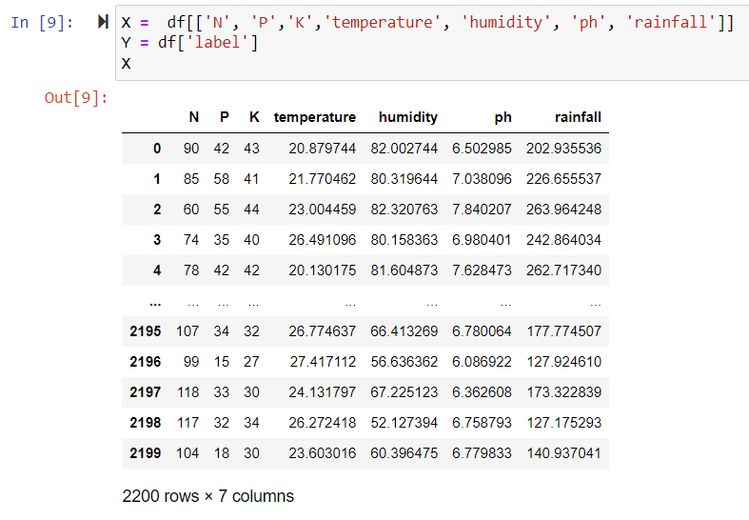
LIST OF FEATURES
These are the features, we used to train and test for our Machine Learning model.

Slide 13
ALGORITHMS USED
Logistic Regression
K Nearest Neighbours
Random Forest
Support Vector Machine
Naive’s Bayes Algorithm
Decision Tree
Gradient Boosting

Slide 14
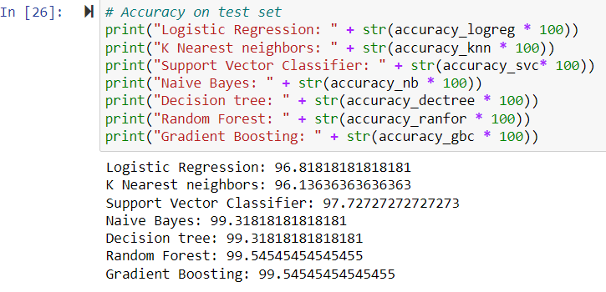
ACCURACY OF ML ALGORITHMS

Slide 15
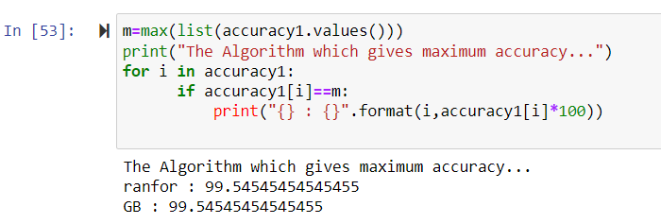
FINDING ALGORITHM WITH HIGH ACCURACY
We have found that, “Random Forest Algorithm” and “Gradient Boosting” are achieving the highest accuracy among all the algorithms.

Slide 16
REFERENCES
[1] Aditya, Param Patil, Vatsa Nagaria, Shobhit , Sunil Ghane’s “Soil Analysis and Crop Recommendation using Machine Learning” in Institute of Electrical and Electronics Engineers(IEEE) in 2022.
[2] Daneshwari ,Ashok V, Vijayalaxmi Anupama’s “Crop Recommendation Using Machine Learning Algorithm” in Institute of Electrical and Electronics Engineers(IEEE) in 2022.
[3] Shilpa, prem kumar , anmol anmol, Aishwarya,karuna rohilla, Kumar shaurya’s “Crop Recommender System Using Machine Learning Approach” in Institute of Electrical and Electronics Engineers(IEEE) in 2021.

Slide 17
REFERENCES
[4] Soham Chakraborty and Sushruta Mishra’s “A Smart Farming-Based Recommendation System Using Collaborative Machine Learning and Image Processing” in Springer in 2022.
[5] Shariff, Shwetha R B, Ramya O G, Pushpa H, Pooja K R’s “Crop Recommendation using Machine Learning Techniques” in International journal of engineering research & technology ICEI – 2022 (Volume 10 – Issue 11) in 2022.
[6] Abhinav Sharma, Muskaan Bhargava, Akshay Vijay’s “AI-Farm: A crop recommendation system” in Institute of Electrical and Electronics Engineers(IEEE) in 2022.

Slide 18
REFERENCES
[7] R. Kumar, M.P. Singh, P. Kumar and J.P. Singh, “ Crop Selection Method to Maximize Crop Yield Rate using Machine Learning Technique,” in Proc. 2015 Int. Conf. Smart Technol. and Manage. for Comput., Commun., Controls, Energy and Mater.
[8] A. T. M. S. Ahamed et al., “Applying data mining techniques to predict annual yield of major crops and recommend planting different crops in different districts in Bangladesh,” in Proc. 2015 IEEE/ACIS 16th Int. Conf. Soft. Eng., Artif. Intell., Netw. and Parallel/Distrib. Comput.
[9] M. Paul, S.K. Vishwakarma and A. Verma, “Analysis of Soil Behaviour and Prediction of Crop Yield using Data Mining Approach,” in Proc. 2015 Int. Conf. Comput. Intell. and Commun. Netw.

Slide 19
THANK YOU

